Slide 1
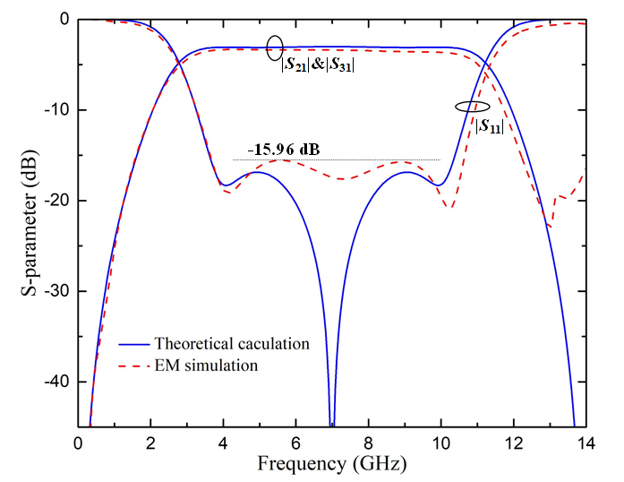
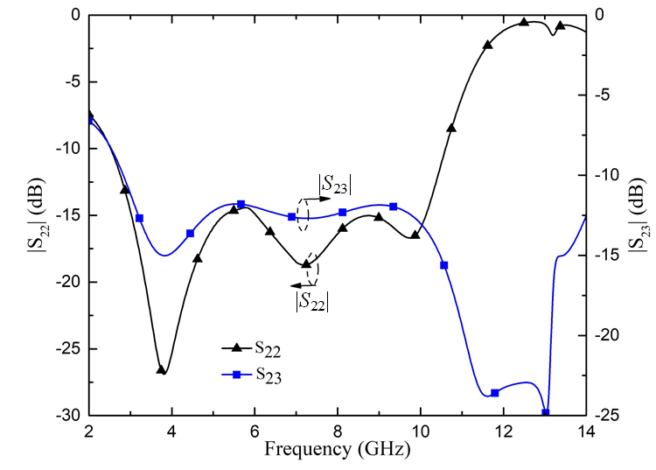
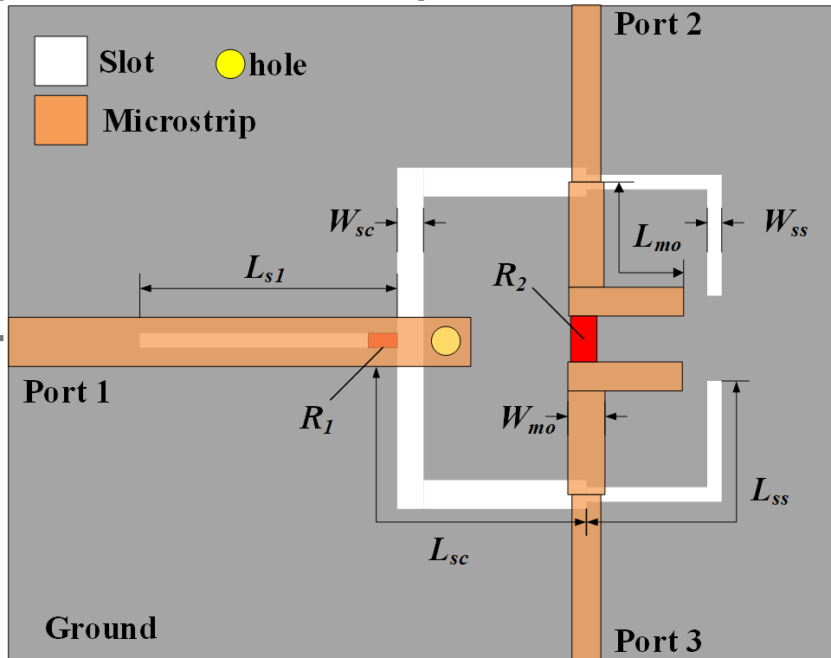
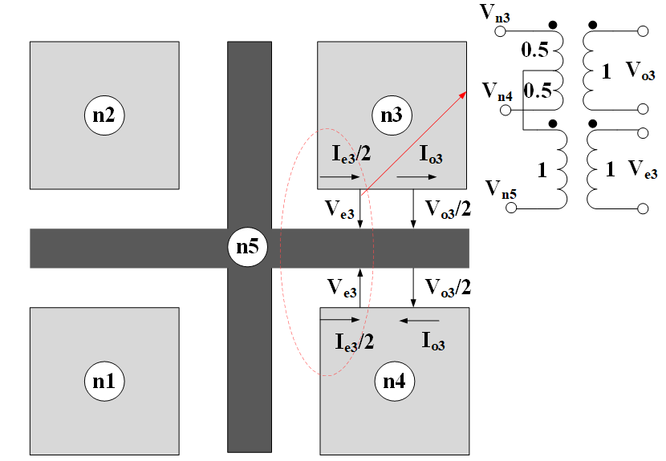
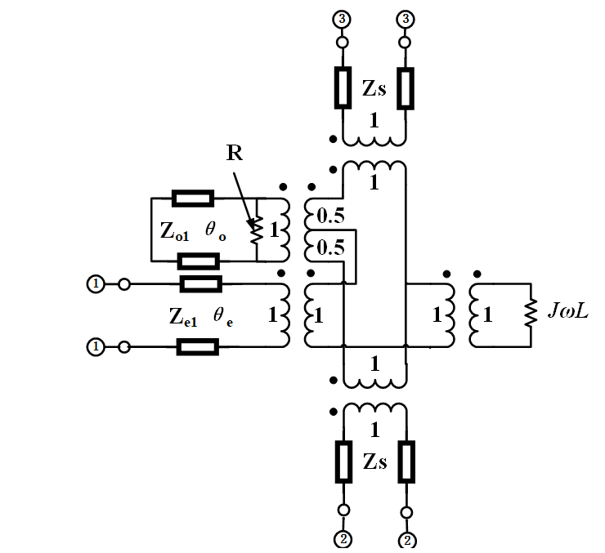
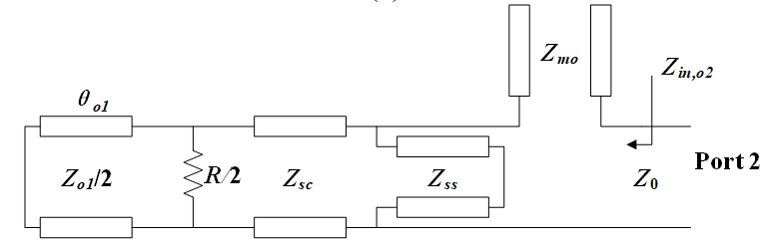
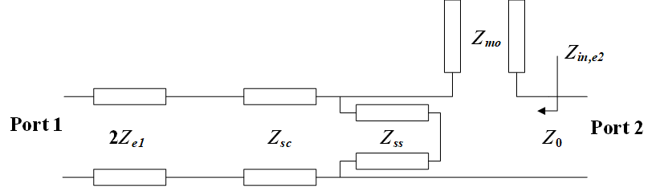
A New compact UWB Filtering Power Divider With
Quasi-Chebyshev Equal-Ripple Response
Zehui Chen, Yongjiu Zhao, Du Chen, Qinmeng Ji, Chao Liu
The ICEICT 2021 in Xi’an, CHINA
Abstract
The simplified odd/even- mode half equivalent circuit of the proposed UWB PD are derived in Fig. 3 (a) and (b). The inductance of L can be ignored since it is so small. Zo1, Ze1 represent the odd/even- mode characteristic impedance of slotline/microstrip respectively. Both cascaded slotline section and open/short stubs are all equal in length θ, and their characteristic impedance are defined as Zsc, Zmo and Zss.
A compact power divider with ultra-wideband (UWB) quasi-Chebyshev filtering response is proposed in this paper. By employing slotted microstrip cross-junction and hybrid slotline/ microstrip resonator, a UWB passband and wide isolation can be realized simultaneously. A perfectly matching is obtained by analyzing the equivalent circuits of even/odd mode. Then, a quasi-Chebyshev filtering response is theoretically realized by using the modified 2-port transmission-line (TL) network with asymmetrical port impedances. To verify our new approach, a prototype UWB PD operating at 3.1-10.8GHz is designed, the fractional bandwidth of the proposed PD is 110% (-15 dB return loss). Simulated results show good agreement with theoretical analysis.
Base on the equivalent circuit presented in Fig.3 (b), the proposed three-pole PD will be synthetically analyzed and designed with a quasi-Chebyshev filtering response. Via multiplying the cascaded ABCD matrices of equivalent circuit, the ABCD matrix of entire circuit can be derived .
Introduction
Results
Since the band covers 3.1-10.6GHz is announced as unlicensed spectrum for UWB system, UWB radio technology has attracted massive attention. Power divider (PD), as an essential component in microwave wireless communication systems, with wideband or even UWB performance is always demanded for increasing the capacity of wireless systems. In this paper, a new compact UWB PD with quasi-Chebyshev filtering response is proposed, as shown in Fig. 1. The wideband isolation is realized by slotted microstrip cross junction with a resistor embedded in it. Then, to get perfectly matching even- odd mode analysis is applied. Next, the filtering response can be synthetically realized with Chebyshev polynomial function. Finally, a 3-pole UWB PD is designed and simulated in the electromagnetic (EM) environment.
(a)
Structure and methodology
(b)
Fig. 4 (a) Insertion loss S21, S31, and return loss S11. (b) Output port return loss S22 and isolation S23.
Fig.1 configuration of the proposed UWB PD.
To verify the design approach mentioned above, a three-pole PD operating at the center frequency f0 = 6.85GHz is designed and simulated in Ansoft HFSS, with the Roger’s RT/Duriod 6010LM substrate, ε_r=10.7 and thickness is 0.635mm. By setting the ripple level LA = 0.08 dB and θ_c=45°, as shown in Fig. 4 (a), with the selection of zmo = 1.083, zss = 1.163 and zsc = 1.414, the theoretical calculation and EM simulation results achieved good agreement.
The parameters of proposed PD are as follows, Wmo= 0.615mm, Wsc= 0.206mm, Wss = 0.113mm, Ws1 = 0.175mm, Lmo = 4.045mm, Lsc = 6.109mm, Ls1 = Lss = 4.754mm, R1 = R2 = 100Ω.
As shown in Fig. 4, the simulated return loss (S11) is below -15 dB covers 3.1-10.8 GHz (110% for fractional bandwidth) and the insertion loss is less than 0.48 dB. As shown in Fig. 4 (b), the isolation (S23) in the entire band range is below -12 dB, and the output in-band return loss (S22) is lower than -14 dB, which shows good matching properties.
(a) (b)
Fig.2 (a) Layout of slotted microstrip cross-junction, dark represents top layer, gray represents the bottom layer. (b) Equivalent circuit of the slotted microstrip cross-junction employed in the proposed PD.
CONCLUSION
(a) (b)
In this paper, a compact UWB power divider with quasi-Chebyshev filtering response is proposed. Different from conventional PDs, the thin slot etched beneath microstrip with an isolation resistor realizes a wideband isolation. Odd and even mode are separated in different paths by employing slotted microstrip cross junction. After synthetical analysis in designing the UWB PD, the perfect matching and quasi-Chebyshev response were realized theoretically. The simulated results obtained from EM full-wave simulation show good agreement with theoretical analysis.
Fig.3 (a) half simplified odd-mode circuit of PD (b) half simplified even-mode circuit of PD
Team Member
Professor Yongjiu Zhao, Zehui Chen, Du Chen, Qinmeng Ji, Chao liu, jiang long Du
Dr. Chen Yu, Dr. Wenjun Qi
Contact Person: Zehui Chen
E-mail: chenzehui@nuaa.edu.cn
College of Electronic and Information Engineering
Nanjing University of Aeronautics and Astronautics
29 Jiangjun St., Nanjing, China, Post Code: 211106

