Slide 1
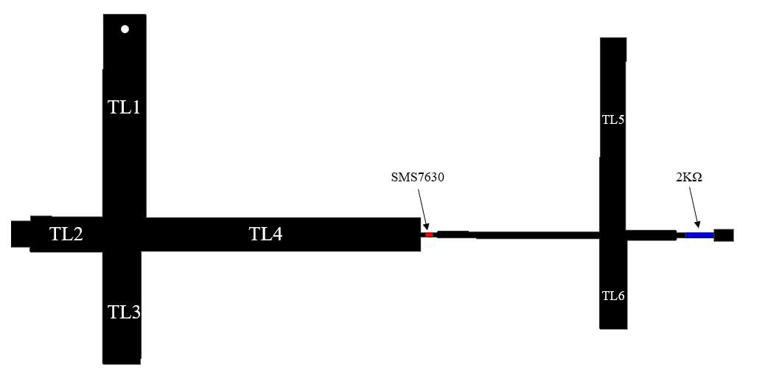
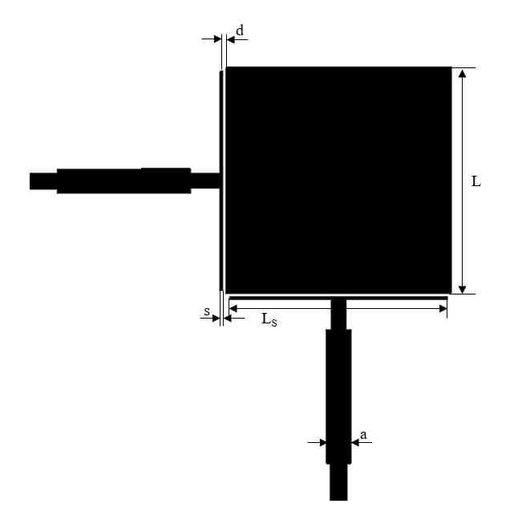
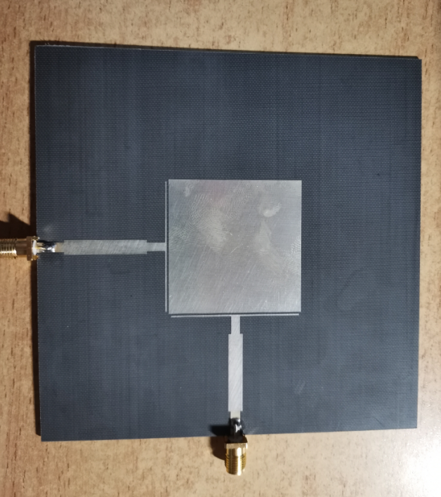

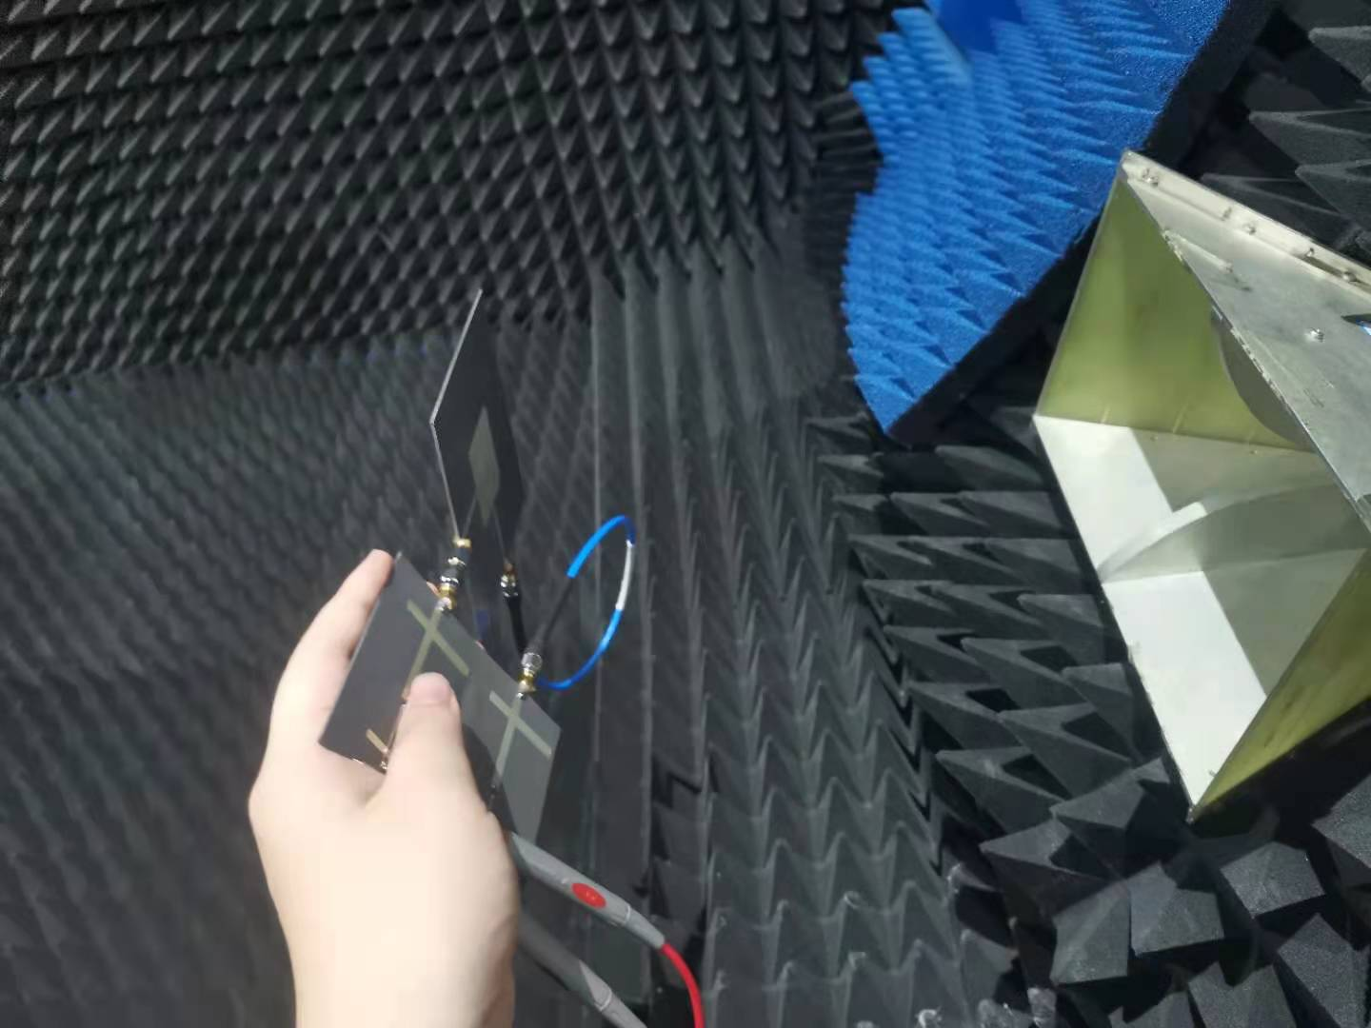
A novel dual polarized rectenna for Ambient RF Energy Harvesting
Yihang Fan, Qian Yan, Ziyue Li*,
School of Information and Communications Engineering, Xi’an Jiaotong University, Xi’an, Shaanxi 710049 China
*yyyyyxb@stu.xjtu.edu.cn
Abstract- A novel dual polarized rectenna for collecting RF energy is proposed. With the development of communication industry, more and more miniaturized devices need continuous and stable power supply. Considering the distribution of radio frequency (RF) energy in the environment, collecting RF energy in the environment for power supply of miniaturized devices has become the research focus. In this paper, a 2.45GHz rectifying antenna based on dual polarized antenna and single voltage rectifier circuit is proposed, which has high conversion efficiency. The measured results are in good agreement with the simulation results. It can be used for energy collection in low power density environment.
Figure 2. Structure diagram of the rectifier.
INTRODUCTION
In recent years, with the coverage of 5G technology, a variety of emerging technologies such as the Internet of Things, smart cities and so on are flourishing. At the same time, the high cost of battery maintenance and replacement has emerged. Therefore, obtaining wireless energy from the external environment has become a hot spot gradually.
As the most important part of rectenna, rectifier circuit realizes the conversion of RF energy to DC energy through the unidirectional conductivity of rectifier diode. In order to improve the rectifier efficiency, the rectifier circuit needs to meet the requirements of low loss, high sensitivity and dynamic power processing capacity.
Most of the rectifiers studied in most studies do not have high efficiency in simulation in practice, and few studies involve the study of high dynamic range of rectifiers, which results in the design of rectifiers that can’t be made and used in practice. Therefore, this paper is based on this situation. A high efficiency rectifier with high dynamic range (input power range from -15 to 10, load resistance from 500 to 30000) is designed. Its operating frequency is GSM900 (850-910 MHz), GSM1800/4G (1850-1900 MHz). The rectification efficiency is about 70% when the input power is 0 dBm, and it can maintain 30% conversion efficiency in a large dynamic range.
The rectifier is modeled on a dielectric substrate with a dielectric constant of 2.65 and a thickness of 1 mm. TL2, TL3 and TL4 form a matching network, which matches the impedance of the back-end rectifier circuit to 50Ω. TL1 is a quarter-wavelength short-circuit branch, which acts as a short-circuit equivalent to the second and higher harmonic components, avoiding high-order harmonics into the rectifier circuit. In the DC filter, TL5 is a quarter wavelength, which is used to shunt the odd harmonics including the fundamental frequency, and TL6 is an eighth wavelength, which is used to shunt the even harmonics. Fig.3 shows the measured and simulated efficiency of the proposed rectifier varies with frequencies.
Figure 3. Efficiency of the proposed rectifier varies with frequencies.
The overall connection diagram system is shown in Fig.4. The RF energy acquisition system consists of receiving antenna and rectifier. Because the receiving antenna is a T-shaped dual polarization antenna, the system designed in this paper uses two identical rectifying circuits to rectify the RF energy of two output ports, and inputs the converted DC energy into the same resistance. By measuring the power intensity received by the voltage response at both ends of the resistance, the transmission power is calculated by Friis' equation:
The gain of the horn antenna is 10dBi, the input power is 10dBm, the gain of the proposed microstrip antenna is 5dBi, and the resistance is 2000Ω. The distance between the antenna and the transmitting antenna is 0.3m, The antenna received RF energy is about -4.89dBm. Because the voltage across the resistor is about 0.326V, the overall efficiency of the system is 17%. When one port of the antenna is connected with a 50 ohm matching load and the other port is connected with a rectifier circuit, the antenna is a traditional mono-polarized antenna. At this time, when the antenna is rotated, the voltage on the load resistance changes from 0.06V to 0.32V, which has a wide range. However, the overall efficiency of the proposed dual polarized antenna is stable.
Figure 1. Proposed dual polarization antenna.
ANTENNA DESIGN
The radiation patch of T-type coplanar coupling antenna is L × L. The size of coupling line is LS × s. The distance from the patch is d, and the feeder width is a.
When the dual polarization antenna is coupled and fed, the length LS, width s of the coupling line and the distance d from the patch all affect the input impedance. Among them, the parameters d and s have the greatest influence on the input resistance, and the influence of d is greater than that of s; The parameters ls and d have great influence on the resonant reactance. When LS is close to the chip length L, the reactance is smaller, and the coupling effect is stronger when the spacing d is smaller, but the machining accuracy limit d cannot be too small.
The dielectric substrate with a dielectric constant of 2.65 and a thickness of 1 mm is used to process the dual polarization receiving antenna. The upper surface is etched, and the lower surface is not etched. The metal cover is retained. The silver deposition process is used on the surface to prevent oxidation and enhance the conductivity. The isolation between the two port is larger 30 dB.
Figure 4. The system efficiency test.

