Slide 1
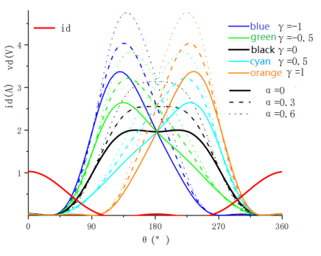
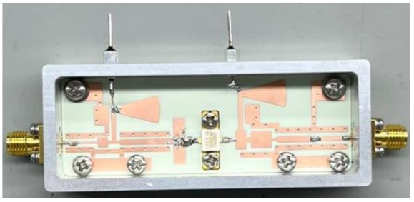
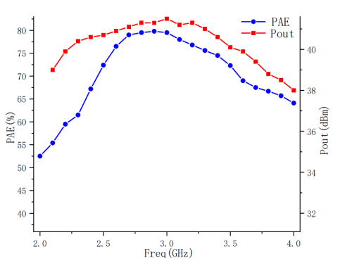
Design of 2.3~3.7GHz Broadband Hybrid Continuous Class F Power Amplifier
Hong Zihao, Chu Ran, Sun Linlin, Liao Jia
Nanjing University of Science and Technology
Abstract
In this paper, on the basis of class F power amplifier, a hybrid continuous class F power amplifier theory is given for the problem of too narrow operating bandwidth of class F power amplifier. The impedance solution space based on this theory is more extensive compared to class F power amplifiers, and the bandwidth is greatly extended at the expense of certain efficiency. According to the theory, a hybrid continuous class F power amplifier with an operating frequency of 2.3~3.7GHz and a relative bandwidth of 46.7% has been designed, and the actual test results show that the range of power added efficiency is 62% ~ 80%, the gain is 11~13dB, and the maximum output power is more than 10W, which has good practical engineering application value.
Theoretical analysis
of the bias circuit uses a fan-shaped microstrip line and a feedthrough capacitor.
The final layout of the hybrid Class F power amplifier is shown as follows, where an arc-shaped 90° corner is added to avoid the drain stage power supply circuit from being too long.
The Class F power amplifier uses a multi-resonant output matching network to control odd harmonics as open circuits and even harmonics as short circuits, and the time domain output waveform behaves as a voltage square wave without overlap and a current half-sine wave. Based on the class F power amplifier, the voltage waveform expression of the drain stage of the hybrid continuous class F power amplifier is proposed as follows:
$$v_{d}(θ)={(1−\frac{2}{\sqrt{3}}cosθ)}^{2}(1+\frac{1}{\sqrt{3}}cosθ)(1−γsinθ)(1−αcosθ)$$
The drain voltage and current waveforms of the hybrid continuous class F power amplifier are as follows:
Processing and Testing
The physical drawing and test results are shown as follows:
The overlap between voltage and current waveforms is minimized to improve energy efficiency and continue the characteristics of high efficiency of Class F amplifier.
Design and Implementation
The design uses CGH40010F transistors. The withstand voltage value and operating frequency of the chip meet the design requirements. The dielectric substrate uses R4350B, and the copper cladding thickness is selected as 35um. In order to prevent RF signals from other frequency points in the bandwidth from entering the power supply, the DC bias circuit selects a quarter wavelength line at the center frequency point in the bandwidth. The filtering part
In the input signal size of 28dBm, the power amplifier in the operating band output power range between 39.4 ~ 41.5dBm, and most of the frequency band output power can be greater than 40dBm. The range of additional power efficiency is 62% ~ 80%. The measured power amplifier performance decreases faster near the edge of the band position, and the simulation results are basically the same, but all meet the requirements of the index.

