Slide 1
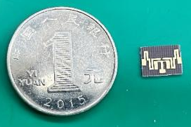
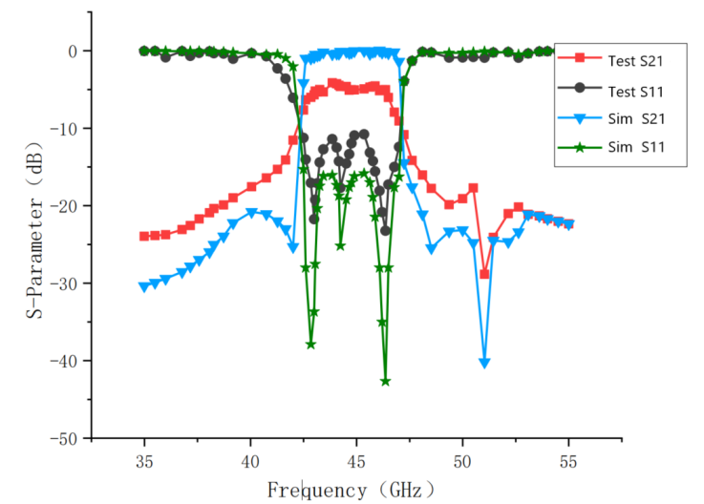
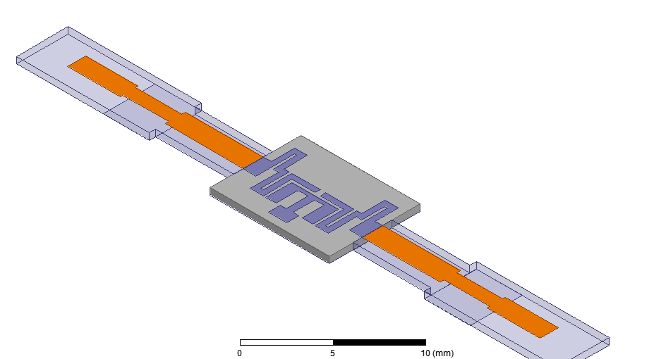
Design of Q-band Filter Based on Folded Step-Impedance Resonator
Shi Shan, Sun Linlin, Chu Ran, Liao Jia
Nanjing University of Science and Technology
Abstract
In this paper, a miniaturized Q-band bandpass filter with high out-of-band rejection based on a stepped impedance resonator is designed. This filter championed a stepped-impedance resonator structure and is loaded with a stepped-impedance branch on the basic SIR, and the transmission zeros have been introduced through a special folded coupling feed line. Compared with the conventional SIR structure, it has more tuning parameters and a wider tuning range for resonant frequencies. A pair of transmission zeros are introduced simultaneously, which can enhance the rejection characteristics of the stop-band. The passband range of the filter is 43-46GHz, the in-band insertion loss is less than 3dB, the in-band return loss is larger than 15dB, and the out-of-band rejection is larger than 20dB in the frequency range of 35-43GHz and 46-55GHz.。
Theoretical analysis
After continuous scanning and optimization, the final parameter dimensions of the Q-band filter based on folded SIR with step-impedance branch loading are derived by considering the results of the influence of each parameter as shown in Table.
An SIR is a resonator consisting of two or more transmission lines with different characteristic impedances.
A T-shaped open-circuit branch is added to the center line of the resonator's one-half wavelength SIR that is symmetrical about the center. The loaded branch is effectively equivalent to forming a section of perturbation to separate the modes to form a passband.
In order to enhance the coupling between source and load while achieving the miniaturization requirement, a new folded coupled feeder structure is designed, and the topology is shown in figure.
L₁ | 0.75mm | W₁ | 0.3mm | LS₁ | 0.68mm
L₂ | 0.375mm | W₂ | 0.15mm | LS₂ | 0.375mm
L₃ | 0.6mm | W₃ | 0.2mm | LS₃ | 0.68mm
L₄ | 0.34mm | W₄ | 0.45mm | LS₄ | 0.83mm
g₁ | 0.1mm | g₂ | 0.3mm | WS | 0.5mm
Processing and Testing
Based on the optimized results of the HFSS simulation, a physical filter was fabricated. The overall size of the filter is only 3.7mm x 3mm, and the performance curve was tested by a vector network analyser, and the comparison between the simulated and measured results is shown below.
Simulation and Analysis
The actual measured S-parameter curve is basically similar to the simulation result curve.The measured in-band insertion loss is less than 4dB, the flatness is about ±1dB, the return loss is larger than 10dB, and the out-of-band rejection at 40GHz and 50GHz is less than -20dB.
Using HFSS electromagnetic simulation software to simulate the three-dimensional structure of the filter, Rogers 5880 was selected as the dielectric substrate, with a dielectric constant of 2.2, a loss angle tangent of 0.0009, and a thickness of 0.127mm, and its three-dimensional simulation model is shown in figure。
Conclusion
Considering the test environment, dielectric substrate material, processing accuracy and assembly, this leads to poor grounding performance. Thus the actual tested in-band insertion loss and return loss is relatively poor. Although there is a certain degree of deterioration in certain result indicators of the actual measured results, the application based on folded step impedance resonator is basically completed.

