Slide 1
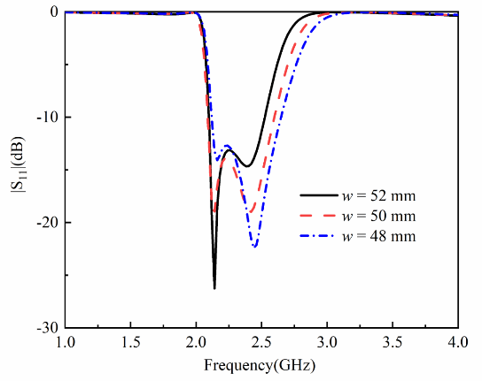
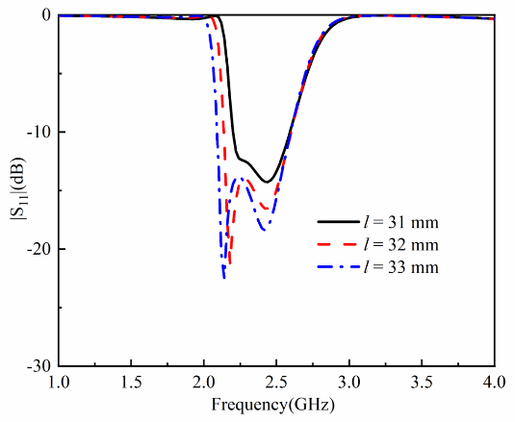
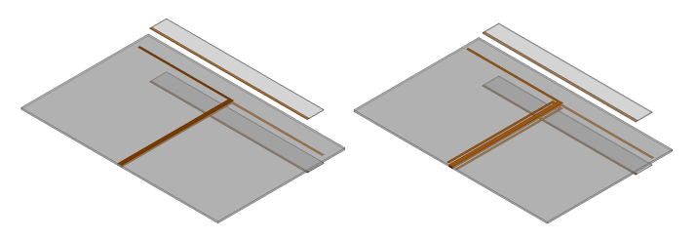
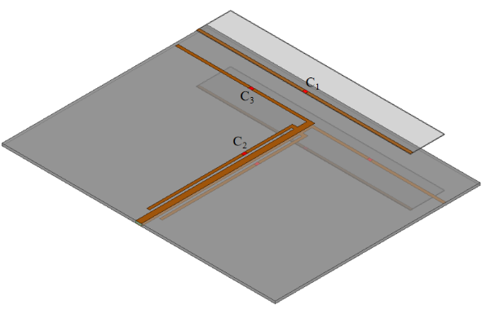
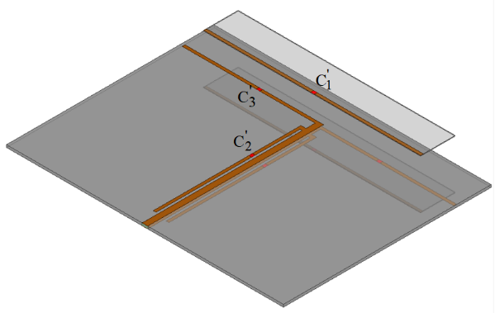
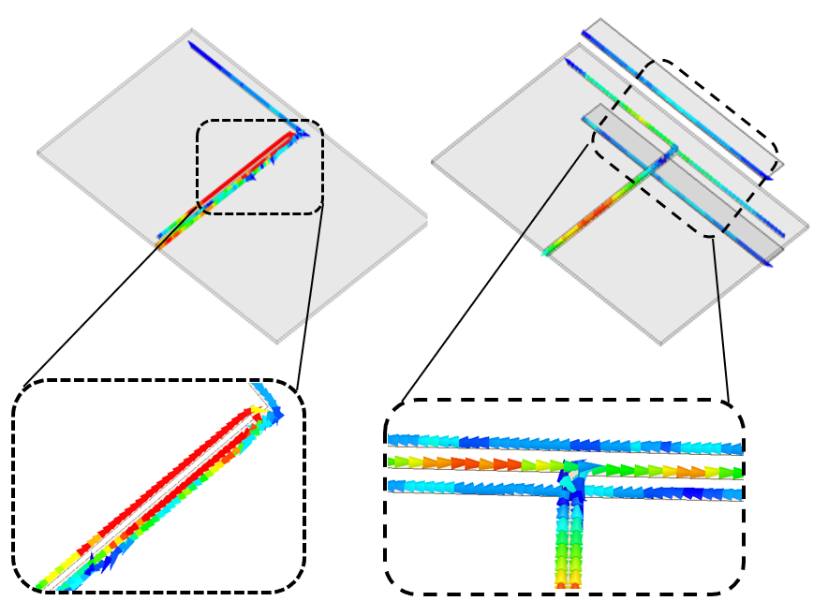
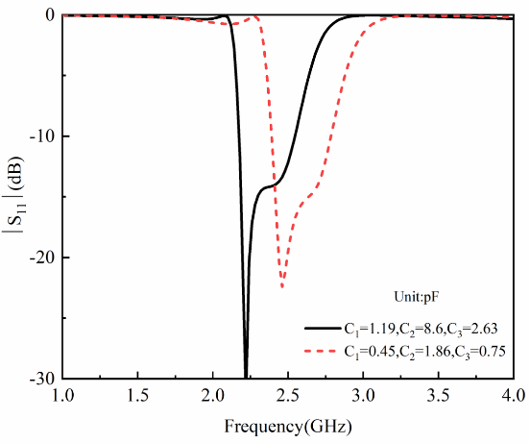
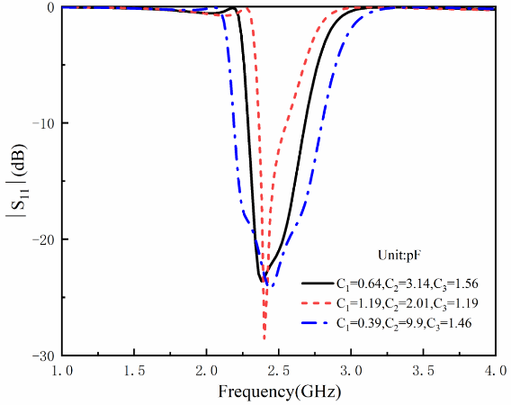
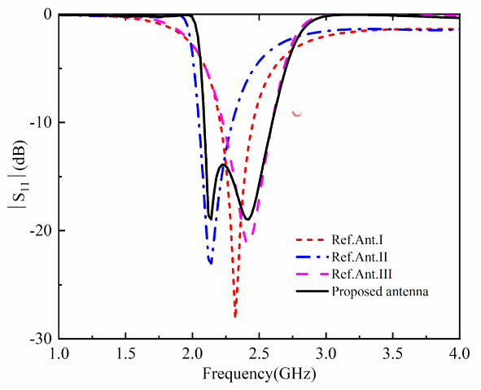
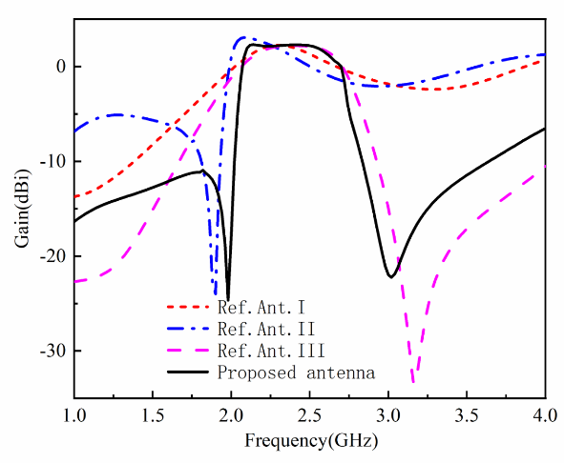
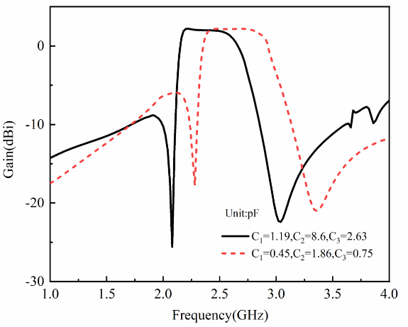
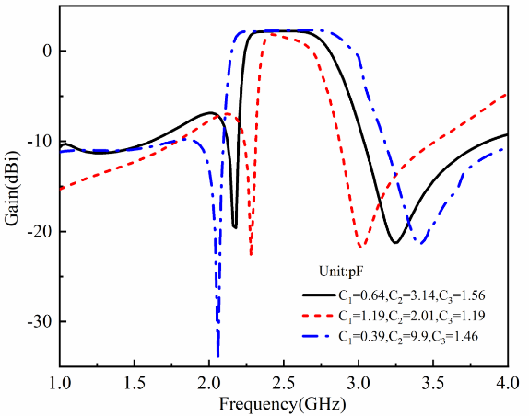
A Filtering Dipole Antenna with Reconfigurable Frequency and Bandwidth
Dongdong Hou¹, G. S. Cheng^{1,2}
¹Information Materials and Intelligent Sensing Laboratory of Anhui Province,
Auhui University, Hefei, China, 230601
²Anhui Province Key Laboratory of Target Recognition and Feature Extraction, Lu’an, China, 237010
Introduction
In order to improve the ability of antenna to resist electromagnetic interference in working environment and reduce the overall size of radio frequency front-end, a dipole filter antenna is designed. Then, in order to improve the flexibility of the antenna system, a filter antenna with reconfigurable frequency and bandwidth is designed, which can communicate according to the allocated spectrum resources.
In this paper, a dipole antenna is designed using symmetrical inverted L microstrip lines. A dipole filtering antenna is obtained by introducing two radiation zeros into the dipole structure. The frequency and bandwidth can be reconstructed by controlling two radiation zeros with variable capacitances. Finally, the center frequency of the antenna can be shifted from 2.3 GHz frequency to 2.6 GHz frequency, and the operating bandwidth can be expanded from 200 MHz to 600 MHz, while maintaining good filtering performance.
Filter-Antenna
Analysis of antenna parameters
Design prosses of filter-antenna.
(a) (b)
(a) (b)
Fig. 4. (a) Effect of parasitic microstrip line on reflection coefficient and (b) Influence of open - circuit struts on reflection coefficient.
Frequency Reconfigurable Filter-Antenna
Configuration of reconfigurable filter-antenna.
(c) (d)
Fig. 1. Configurations of the reference antennas and the proposed filtering dipole antenna.(a) Ant. I, (b) Ant. II, (c) Ant. III, (d) Proposed antenna.
Current distributions.
(a) (b)
Fig. 5. Configuration of the frequency and bandwidth reconfigurable filtering dipole antenna. (a)Antenna front and (b) back of antenna.
Reflection coefficient and Gain
(a)
(b)
(a) (b)
Fig. 2. Simulated current distributions on the proposed antenna at radiation null frequencies. (a) Current distribution of 1.9 GHz and (b) 2.8GHz.
Reflection coefficient and Gain.
(a) (b)
(a) (b)
(c) (d)
Fig. 3. (a) Reflection coefficient and (b) gains of the reference antennas and the proposed filtering dipole antenna.
Fig.6 . (a), (c)Reflection coefficients and (b), (d)gains of the filtering dipole antenna with reconfigurable frequency and bandwidth.
Conclusion
Realization of filter-antenna and frequency reconfiguration:
Two radiation nulls are introduced by loading open branch and parasitic microstrip lines, and a filter dipole antenna structure is obtained. The related parameters are analyzed.
According to the result of parameter analysis, the effective electric length of microstrip line is controlled by variable capacitance, and the frequency and bandwidth are reconfigurable.
The frequency reconstruction range is about 25%, and the bandwidth reconstruction range is up to 400MHz.

